Slide 1
Aliens have landed

Slide 2

Calgary Flames

Slide 3
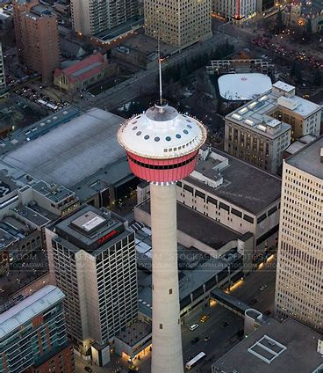
Calgary Tower

Slide 4
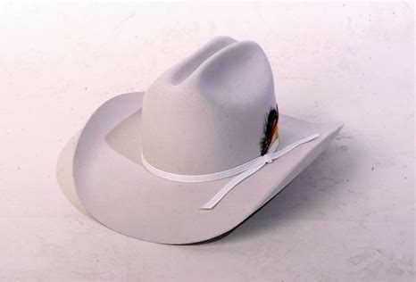
Stenton Cow boy Hat

Slide 5
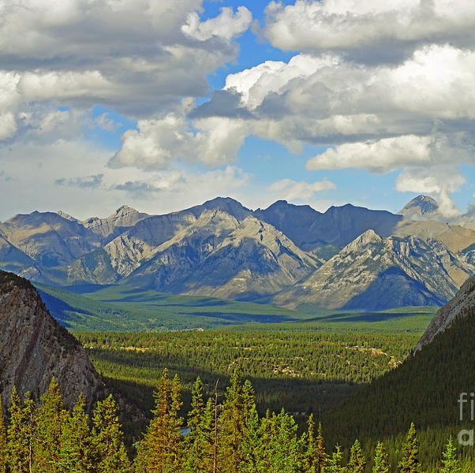
Rocky Mountains

Slide 6

Bow Valley College

